Slide 1
Project Week Presentation
Data Pirates – Junyang Tang, Zongzhen Lin, Jinsong Zhen, Chin-Heng Lin

Slide 2
Data Overview
Data Summary
Data Visualization
Drop missing value
One-Hot encoded variables
Scale on numeric feature
Feature Elimination
Advanced models to select features
Feature Engineering
Agenda
XG Boost
Prophet
Models
Recommen-dations
Business Recommendations
2

Slide 3
Data Summary
Besides the raw data, we added the following features to the dataset for analysis:
Feature Name | Description | Type
CPIAUCSL | Consumer Price Index for All Urban Consumers | Numerical / Monthly
UNRATE | Unemployment Rate | Numerical / Monthly
CCI | Consumer Confidence Index | Numerical / Monthly
PCE | Personal Consumption Expenditure | Numerical / Monthly
GSCPI | Global Supply Chain Pressure Index | Numerical / Monthly
CSI | Consumer Sentiment Index | Numerical / Monthly
Is_holiday | Import from the “holidays” package to identify important US holidays | Categorical (1: Holiday; 0: Nonholiday)
Weekday | Identify if SALES_DATE is on weekday or weekend | Categorical (1: Weekday; 0: Weekend)
DISCOUNT | Calculate the discount rate by PROMO_PRICE (if any) | Numerical / Daily
SUMMARY
FEATURE ENGINEERING
MODELS
RECOMMENDATIONS

Slide 4
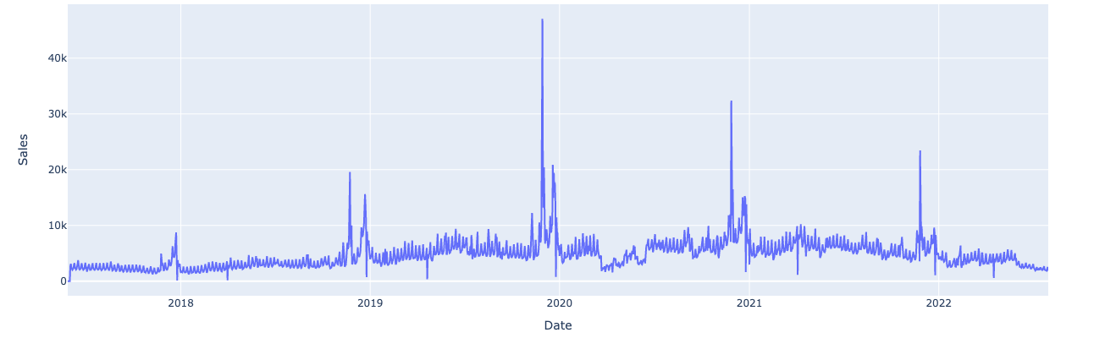
Data Visualization
Aggregate sales daily overview
Sum of sales unit by day
Sales unit
Key observations:
Seasonality and variation: Strong variation exists across years, signalling that there is probably a trend which is different by year
Holiday effect: Strong holiday effect apparently present, particularly obvious on key dates for the retail industry such as Black Friday and Cyber Monday
SUMMARY
FEATURE ENGINEERING
MODELS
RECOMMENDATIONS

Slide 5
Feature Engineering
Drop missing values
One-Hot Encoded Variables
Scale on numeric features
Feature Elimination
Advanced models to select features
Drop missing values
Dropped competitor price since 63% of data are missing
Due to read_csv function errors, there could be erroneous NAN rows, dropped rows with only NAN values
One-hot Encoded variables
Used get_dummies function to encode categorical variables
The purpose is to investigate the effects of categorical variables
Scale on numeric features
Feature Elimination, Advanced models to select features
Detailed on next slide
SUMMARY
FEATURE ENGINEERING
MODELS
RECOMMENDATIONS

Slide 6

Feature Engineering
To investigate the contribution of each data feature, three methods were used:
Feature selection methods
Process
Result
Checking the number of columns in transformed values
In total three features
PCA
Build a series of decision trees based on reduction of the loss function by features
Features Chosen:
Discount, Price, Consumer Confidence Index
Gradient Boosting Regressor
Use multiple decision trees to make predictions
Features Chosen:
Discount, Price, Consumer Confidence Index
Random Forest Regressor
SUMMARY
FEATURE ENGINEERING
MODELS
RECOMMENDATIONS

Slide 7
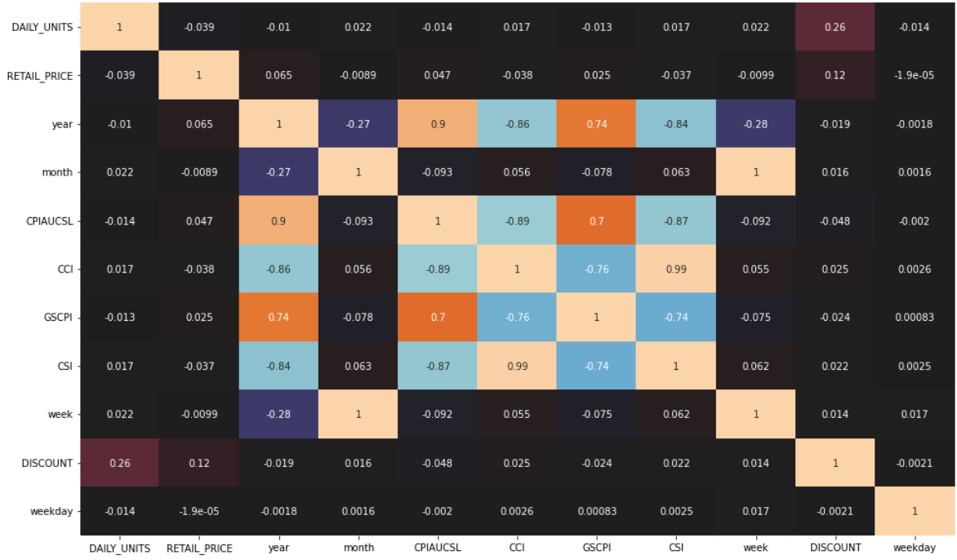


Correlation Matrix
Findings
Correlation between
Actual sales unit vs. Other Numeric Features
Discount Percentage
Price
Discount percentage and price have stronger correlation with daily units
SUMMARY
FEATURE ENGINEERING
MODELS
RECOMMENDATIONS

Slide 8
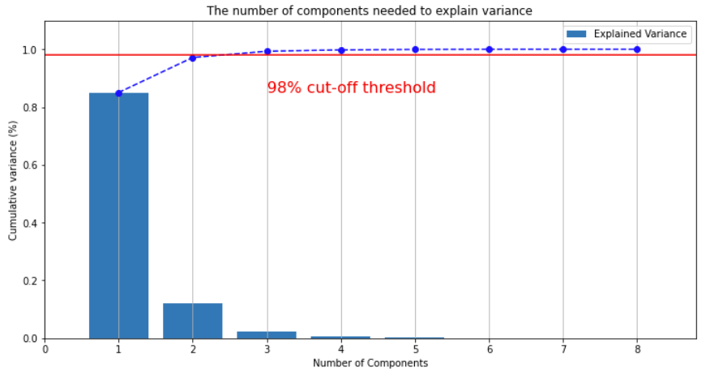
Feature Selection (After Log Transformation)
SUMMARY
FEATURE ENGINEERING
MODELS
RECOMMENDATIONS

Slide 9
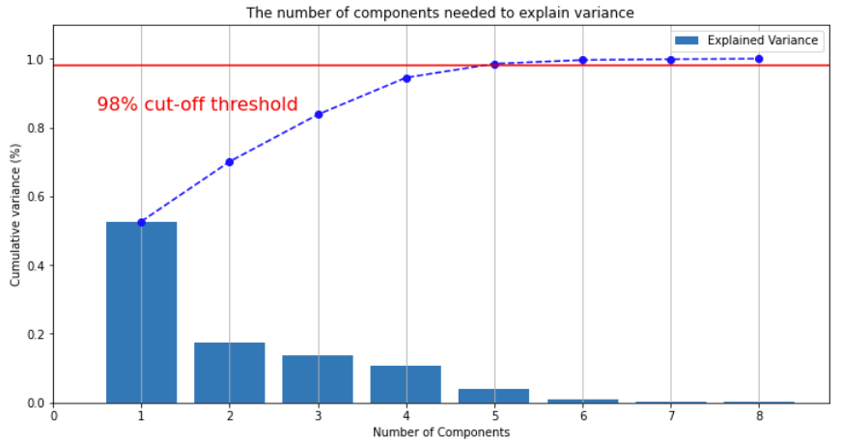
Feature Selection (After Standardization)
SUMMARY
FEATURE ENGINEERING
MODELS
RECOMMENDATIONS

Slide 10
XGBoost: Boosting yields an acceptable RMSE results of ~7
Validation Set:
Actual sales unit vs. Predicted sales unit
Sales unit
Observations
1
RMSE heavily influenced by outliers
SKU #430 & SKU # 469 contribute to 52% of RMSE
Effect of discount hard to forecast due to lack of knowledge of promotion scale/format
1
2
Actual sales and sales prediction generally stay close
2
Despite the variation of RMSE across individual SKUs, on a per day perspective the XGBoost model did a good job
3
Extraneous data’s contribution is limited due to data granularity
08/01/22
08/02/22
08/03/22
08/04/22
08/05/22
08/06/22
08/07/22
Extraneous data’s contribution to prediction is very limited
since economic data are usually released on a per month basis
RMSE
Actual Average
Prediction Average
SUMMARY
FEATURE ENGINEERING
MODELS
RECOMMENDATIONS

Slide 11
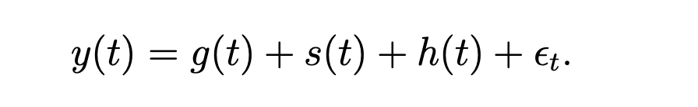



Prophet Introduction: Modelling time series with multiple seasonalities
Prophet as a decomposable time series model
Advantages of Prophet
1
Robust to outliers
Prophet can automatically detect anomaly data…
And remove outliers that can potentially affect forecast
g(t): Trend function which models the non-periodic changes in the value of the time series
s(t): Represents periodic changes (e.g., weekly and yearly seasonality)
h(t): Represents the effect of holidays
Error term represents any idiosyncratic changes which are not accommodated by the model
2
Robust to missing data
Prophet can automatically impute data if certain date values are missing
3
Handle seasonal variation well
Prophet can default fit weekly and yearly seasonality
Since this dataset has strong trend, holidays effects, and several apparent outliers, Prophet will be ideal for time series forecast
SUMMARY
FEATURE ENGINEERING
MODELS
RECOMMENDATIONS

Slide 12
Prophet: RMSE reaches 3.32, achieving a ~51% cut
Key Insights
Forecast runs with a low RMSE for the first four days, produces higher RMSEs for the next two days, and then decrease back to the average daily level of RMSE. The expected sales are much higher than the actual sales during 8/5/22 - 8/6/22.
Prophet is sensitive to the significant outliers from daily sales, leading to less accurate prediction. The model is well designed to take seasonality into consideration, but multiple seasonal patterns can worsen the model performance
1
2
SUMMARY
FEATURE ENGINEERING
MODELS
RECOMMENDATIONS

Slide 13
Recommendations
Price Leadership Strategy
Why?
We find out that the variable "Discount" contribute most to explaining daily sales
Argument
Even though such a strategy seems like would lead to pain in short, we believe the overall increase in sales from this strategy and offering more incentives will more than offset the short-term losses.
Marketing Strategy
Why?
Personalized marketing is sending right products to the right customer at the right time is critical and making products accessible to expand customer segments.
Solution
Focus on marketing products with a price between 25%-50% quantile, invest more on marketing campaigns and stay active on marketing channel like social media, email, video ads, local newspapers, word-of-mouth (viral marketing), etc.
SUMMARY
FEATURE ENGINEERING
MODELS
RECOMMENDATIONS

Slide 14
End
Thank You for Your Time
Q & A

